Slide 1
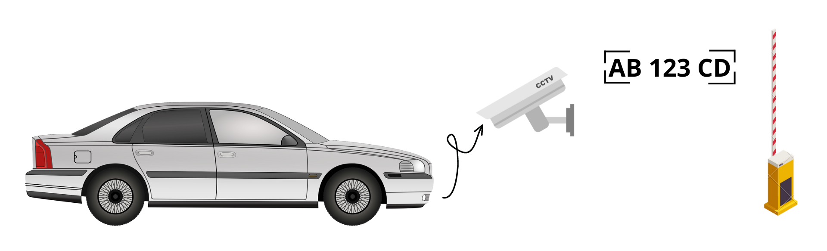
Licence plate gate system
Presentation of IoT final project

Slide 2
Goal of the system
Exploit licence plates as unique keys to open gates and barriers
Build an IoT network to connect distributed and eterogeneous devices
Implement neural networks models to complete critical steps

Slide 3
System’s logic flow
Edge device
Fog device
Fog device
Cloud server
Plate detection
Environment acquisition and transmission
Char recognition
Record evaluation
Edge device
Transmission and actuation

Slide 4
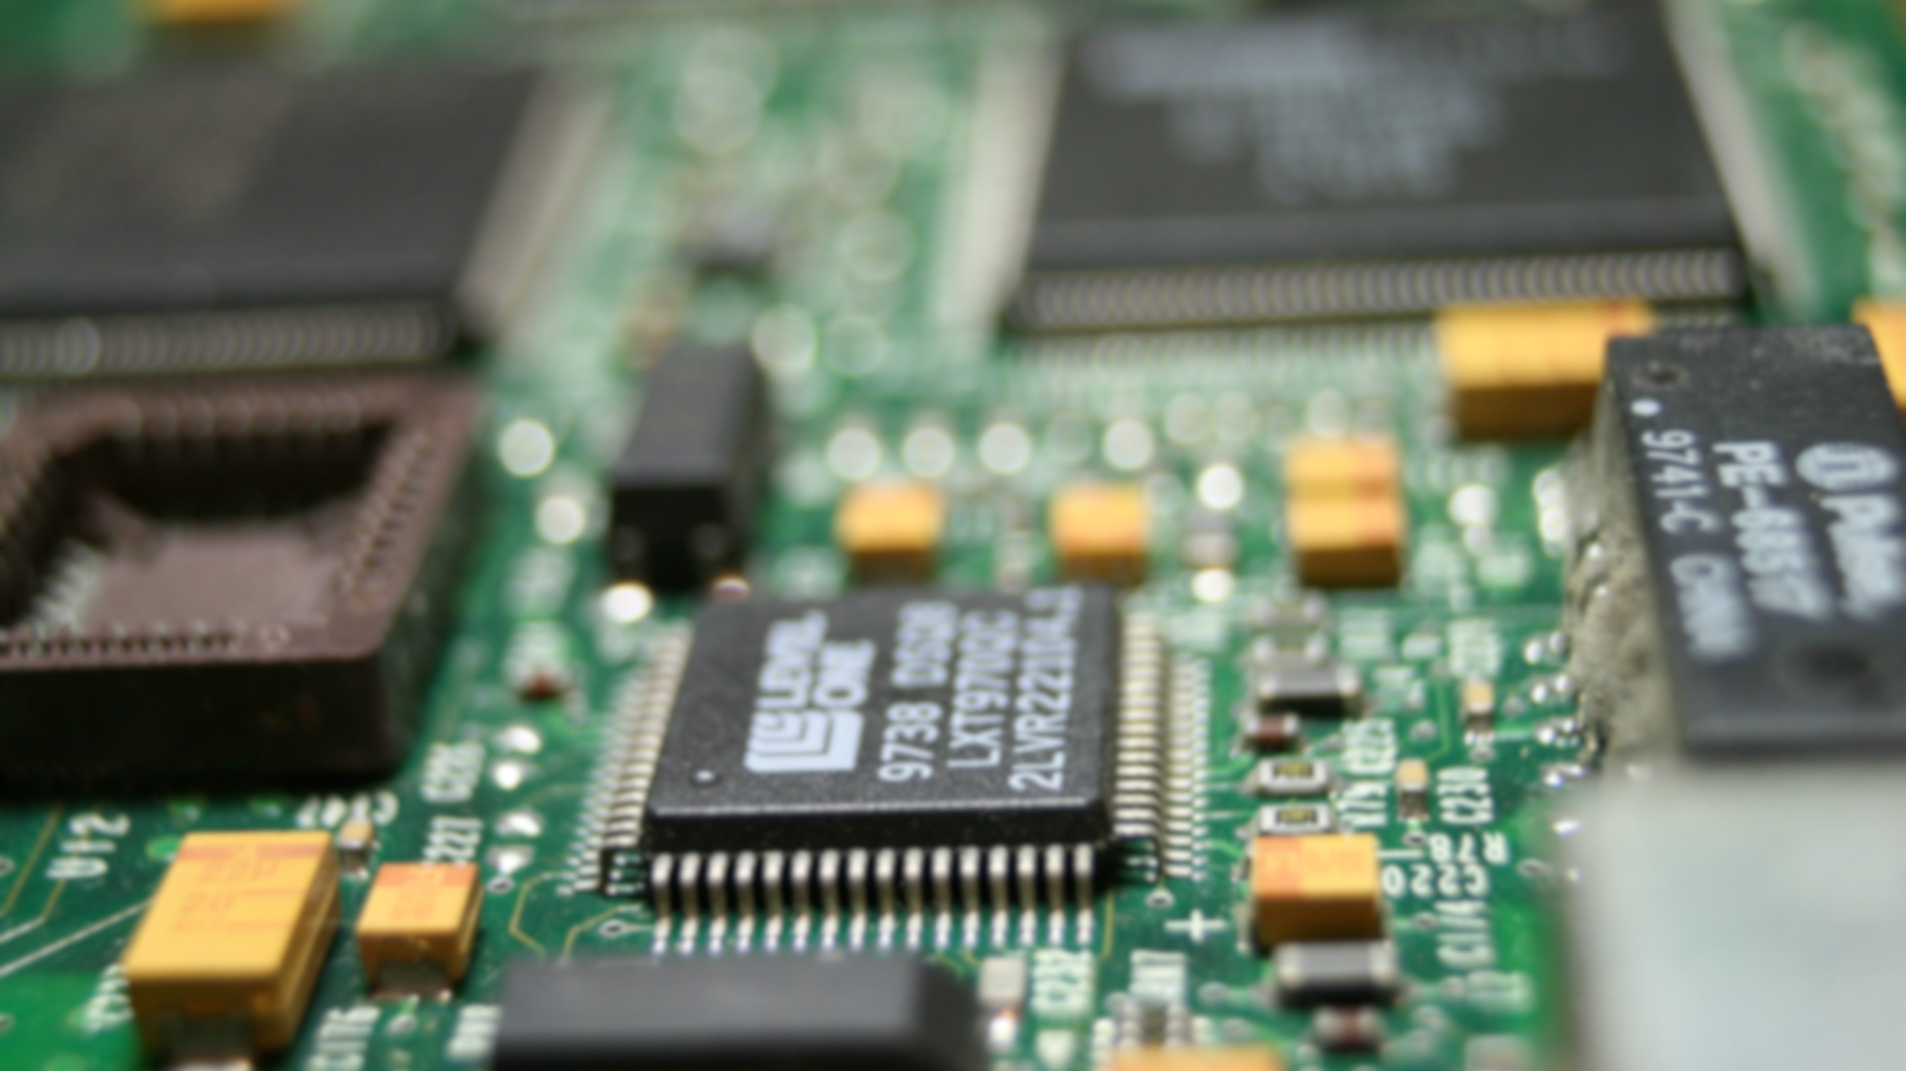
Hardware implementation
Edge device
Fog device
Cloud server

Slide 5
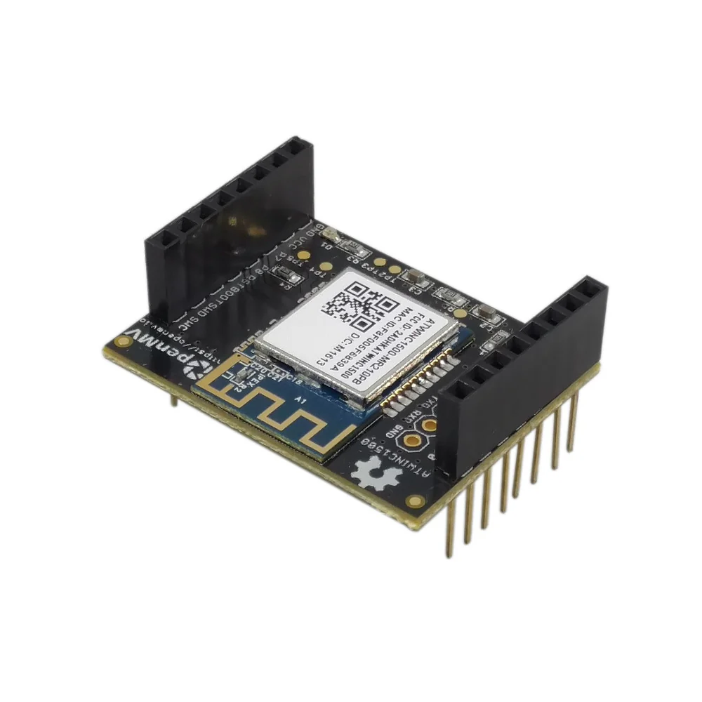
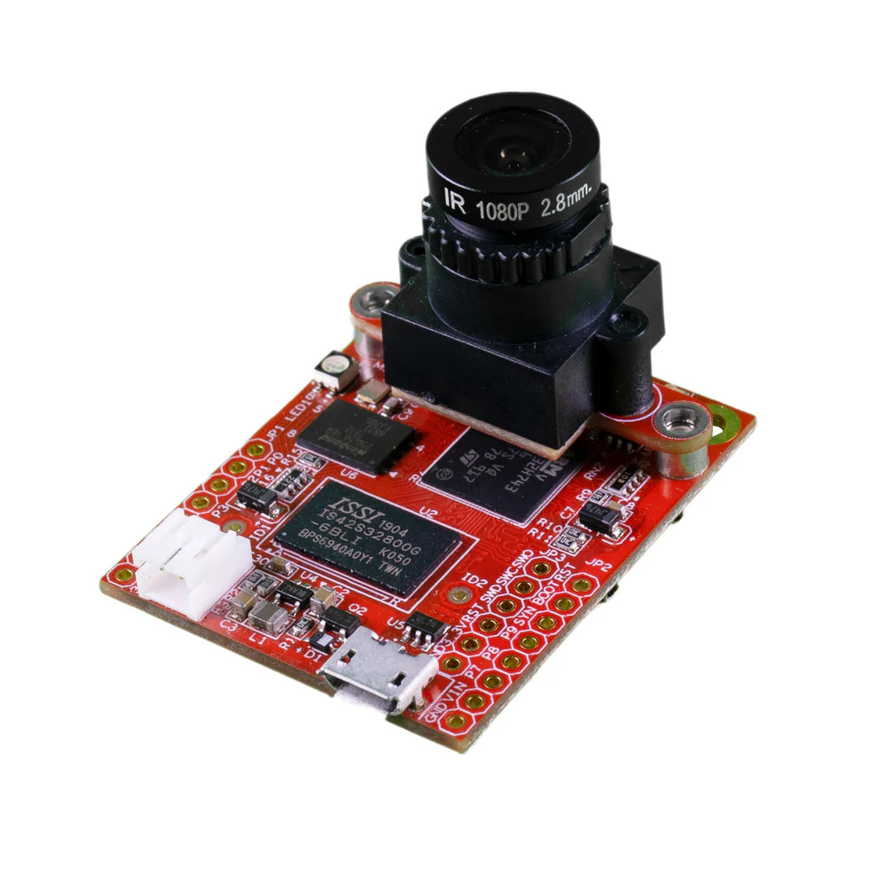
Hardware: edge device
Takes snaphots of the environment
Sends fragmented data to the system
Performs actions on received messages
Camera module: OpenMV Cam H7 Plus
Connection expansion: WiFi shield

Slide 6
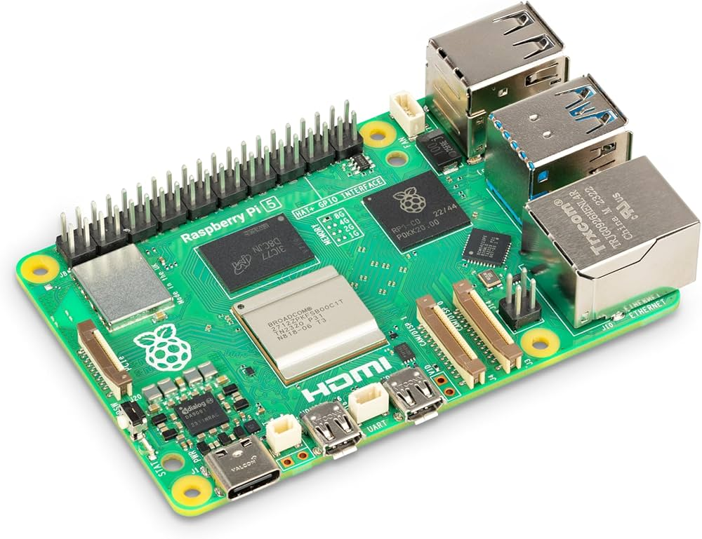
Hardware: fog device
Reconstructs messages of the edge device
Forwards data to the plates model server
Runs chars recognition model
Connects to database
Hosts core functionalities
Acts as gateway
Can be installed even on pc or programmable boards (Raspberry pi)

Slide 7
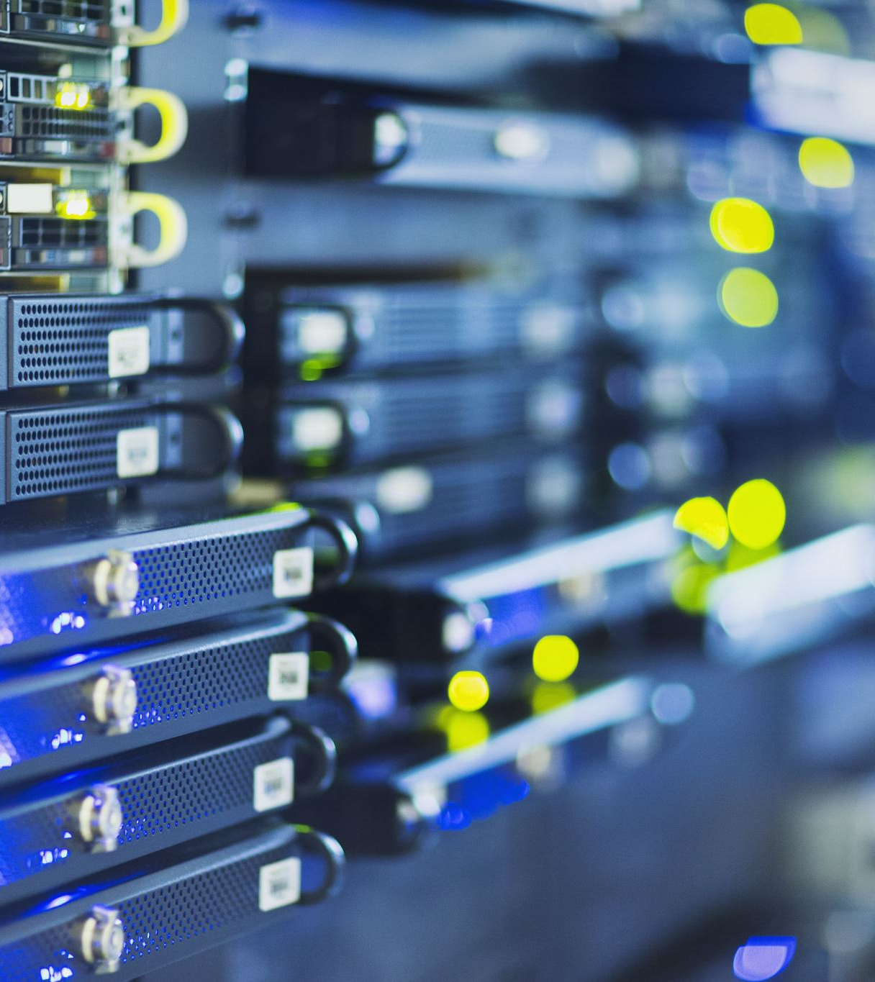
Hardware: cloud
Train and run plate’s neural network
Hosts messaging server
Hosts database
Hosts user’s dashboard
Can be merged with fog device or hosted on different machines

Slide 8

Framework implementation
Communication protocol
Plate detection model
Char recognition model
Database
User interface

Slide 9
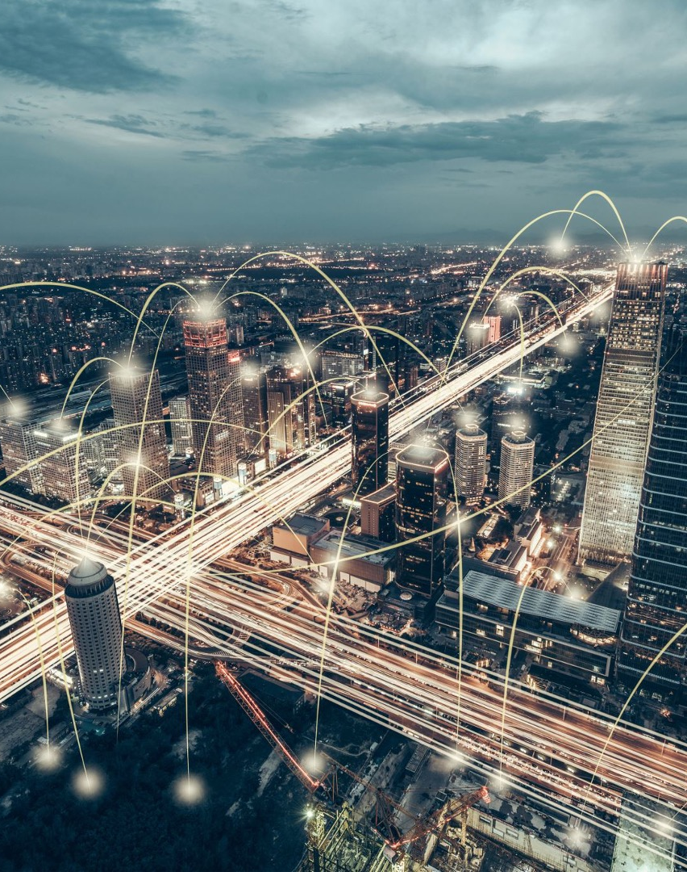

Communication protocol
MQTT protocol for messages exchange
Mosquitto eclipse broker
Two topics for messages
One topic for debug insights

Slide 10
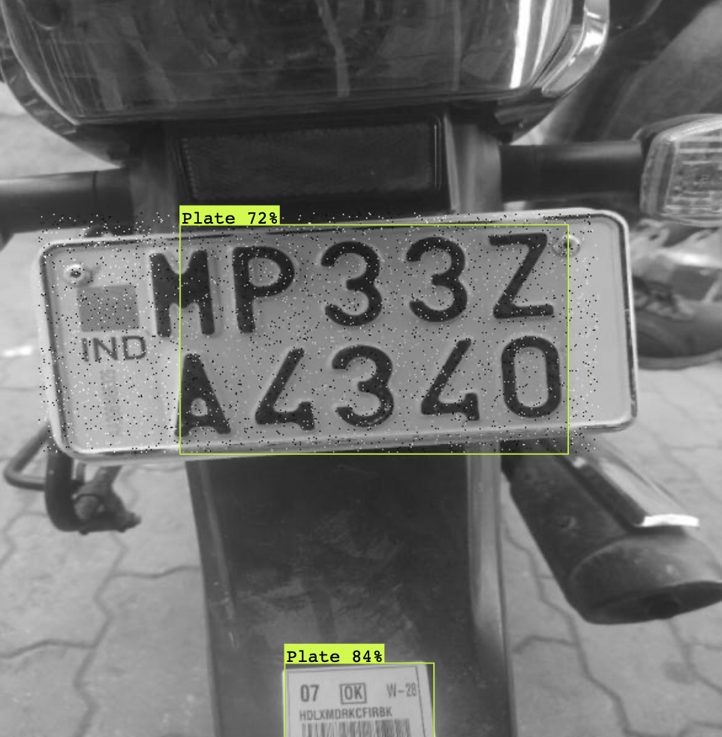

Plate detection model
Supports many training models like object detection and classification
Trained and hosted on Roboflow servers
Runs with API linked with the fog device

Slide 11
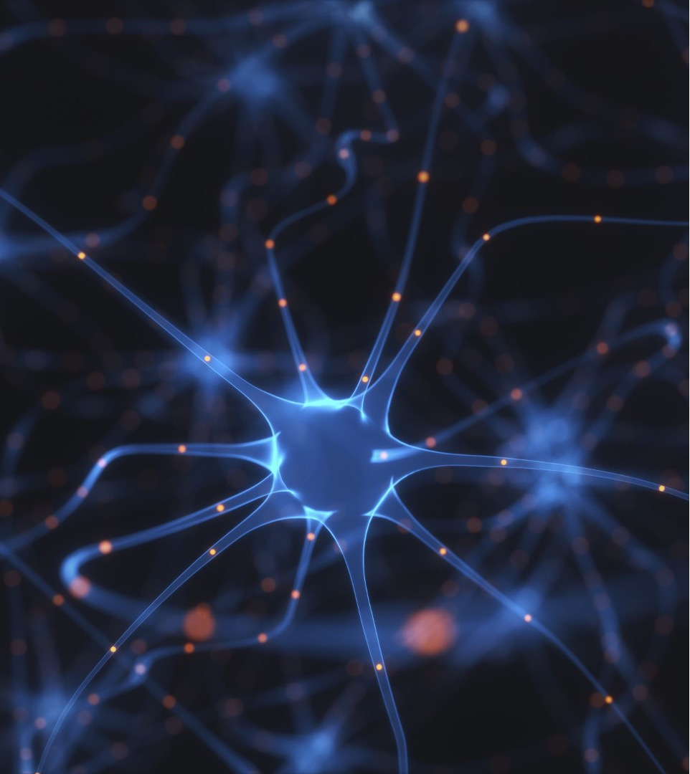

Char recognition model
Provides character and numbers recognition
Pre-trained model by Keras
Can work locally
Based on Tensorflow libraries

Slide 12
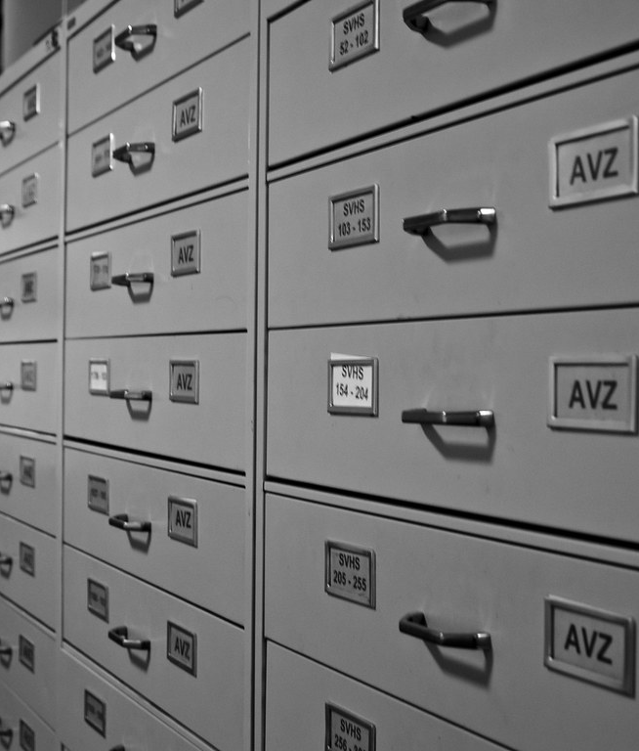

Database
Time-series data
Real-time analytics
Designed for IoT applications
Based on InfluxDB database

Slide 13
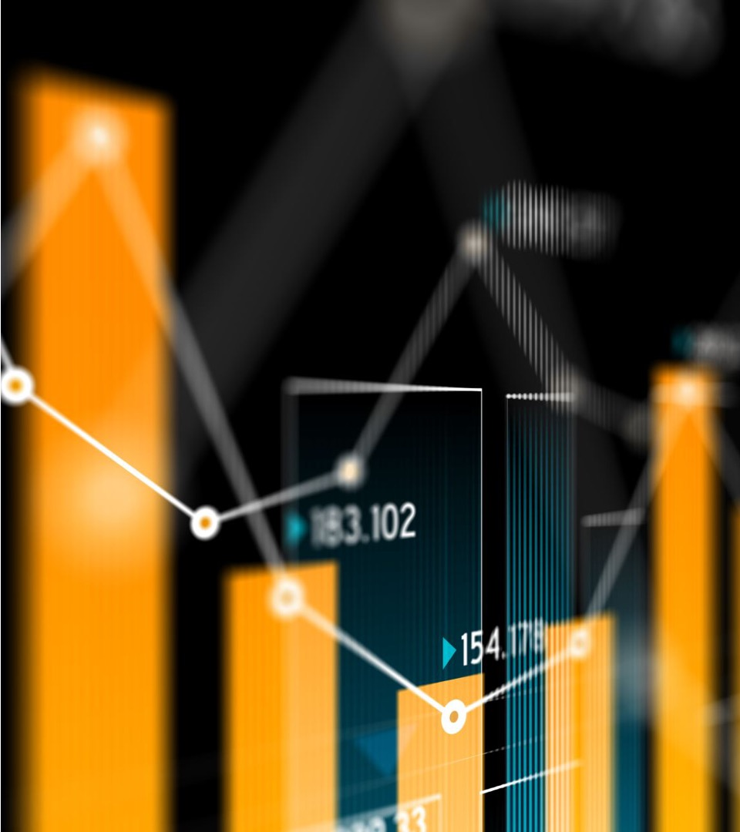

User interface
Colorful dashboard interface
Highly customizable
Real-time analytics
Native integration with many data sources
Based on Grafana

Slide 14

Software implementation
Configuration files
Messages synchronization and transmission
Neural models training and connection
Custom database
Dashboard layout
States machine
Debug and logging

Slide 15
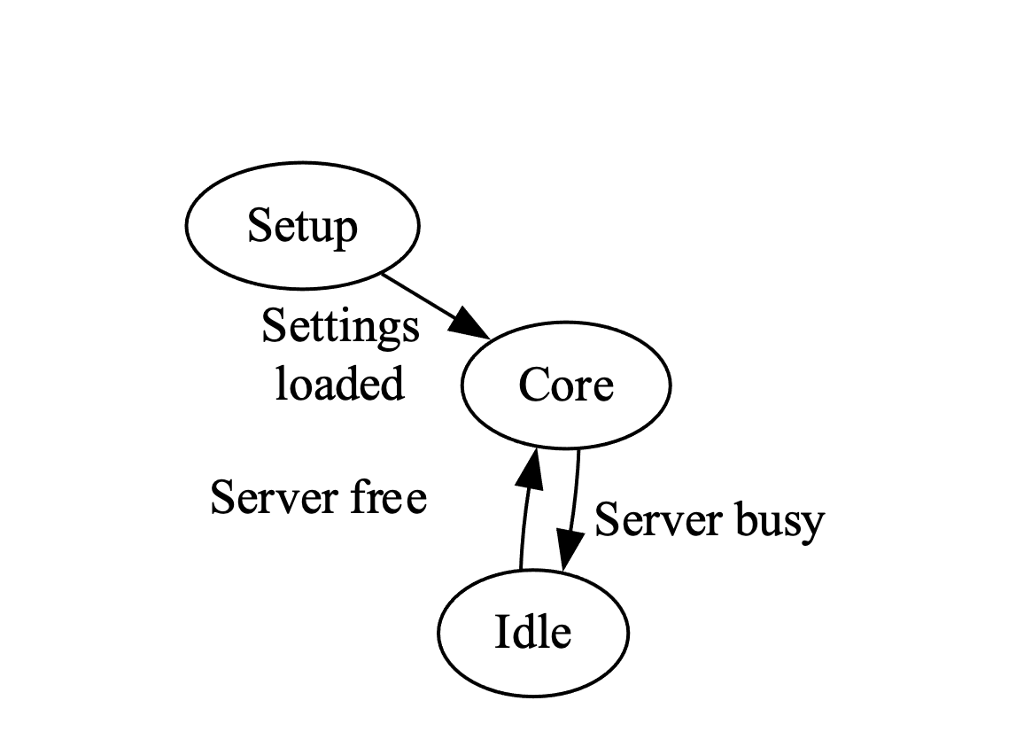
State machine: edge-device
Setup of camera and connections
Image acquisition and fragmentation
Messages creation and publish to “cam_target” topic
Polling for incoming messages on “plate_check” topic
Idle state for busy server

Slide 16
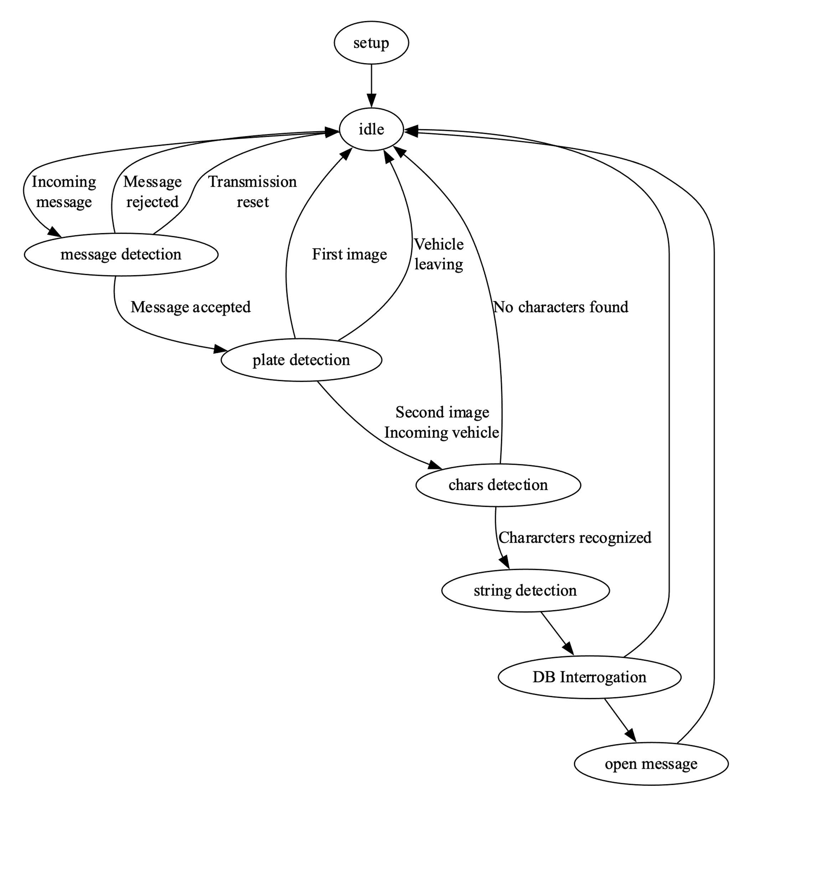
State machine: fog-device
Setup of connections (WIFI, MQTT)
Setup of services (Roboflow, InfluxDB, Grafana, logger)
Core system management

Slide 17
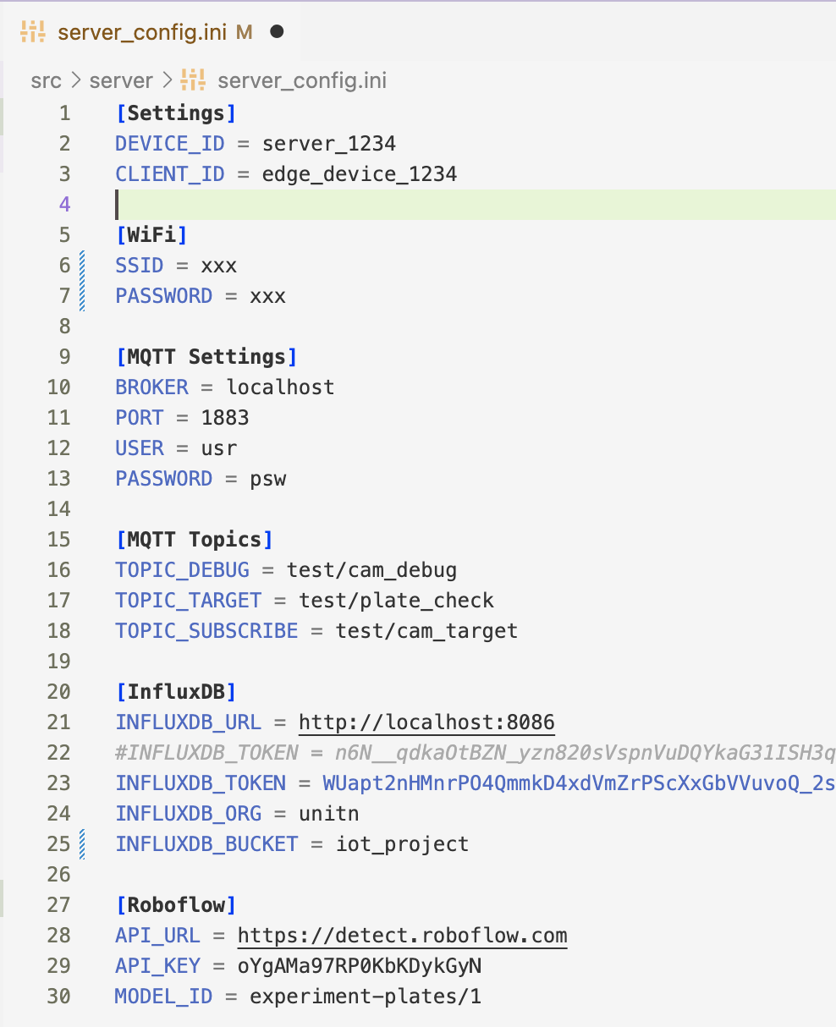
Custom settings files
Both for edge and cloud devices
Wireless connection settings
MQTT settings and topics
Influxdb settings
Roboflow settings

Slide 18
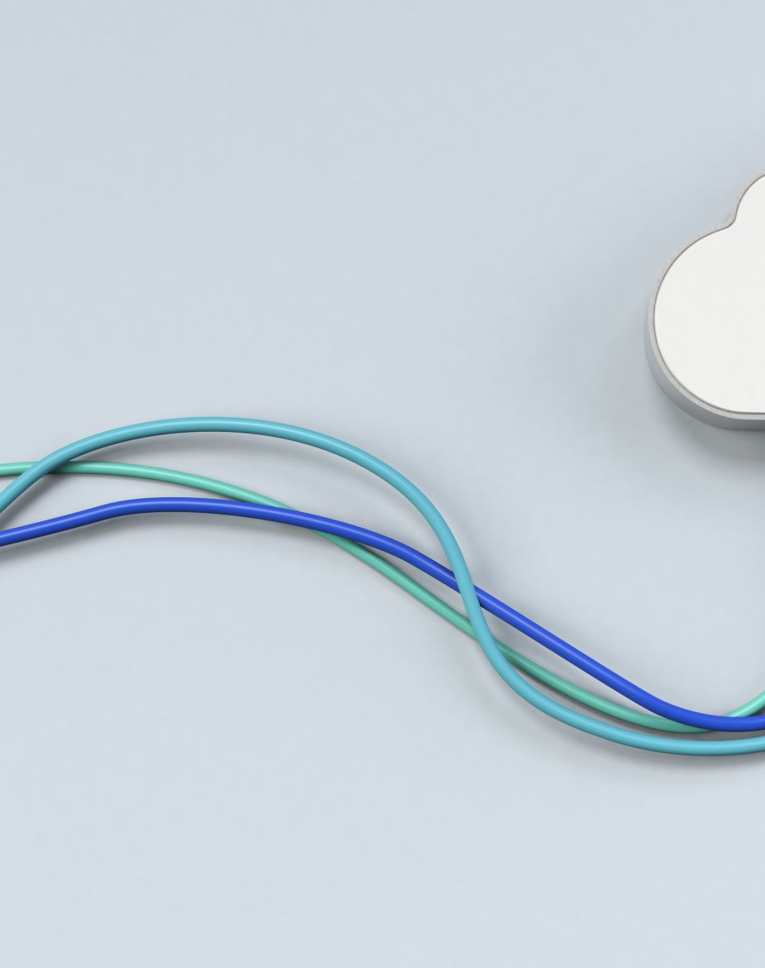
Messages transmission
Access control: username and password
Payload fragmentation: field “fr_n” for fragment reference
Busy & available status: when some tasks are running and new messages are dropped
Missing messages management: restart transmission if fragments are not received

Slide 19
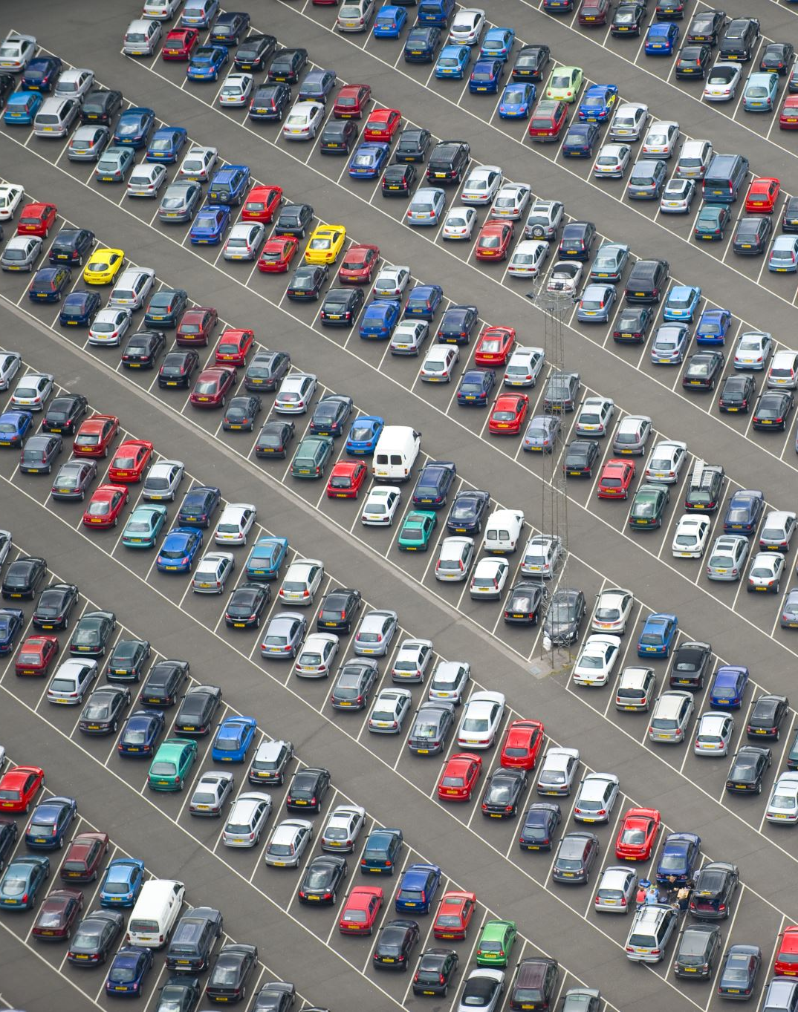
Model training
Model trained with over than 2600 photos
Identifies car plates with 95.9% precision
Supports multiple objects detection

Slide 20
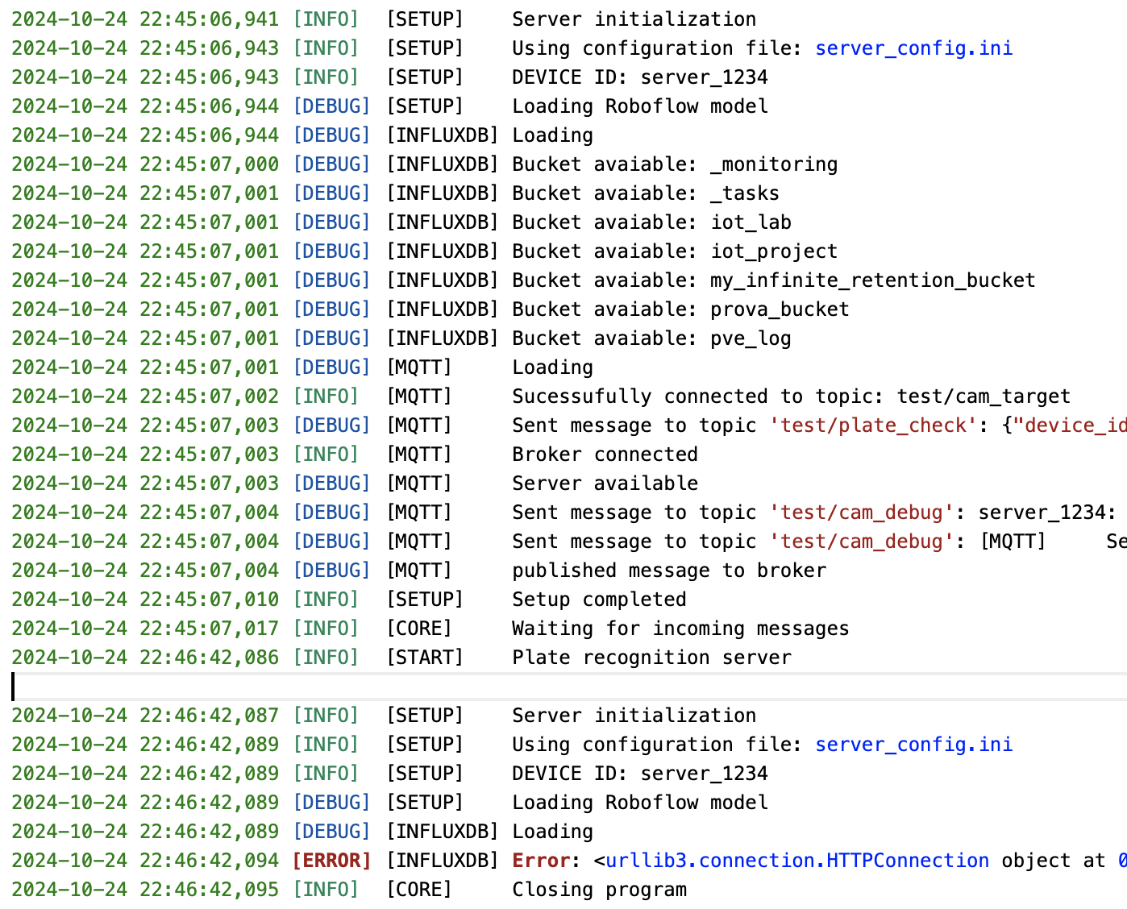
Debug and logging
Console debug for edge and fog devices
Logging file for fog device

Slide 21
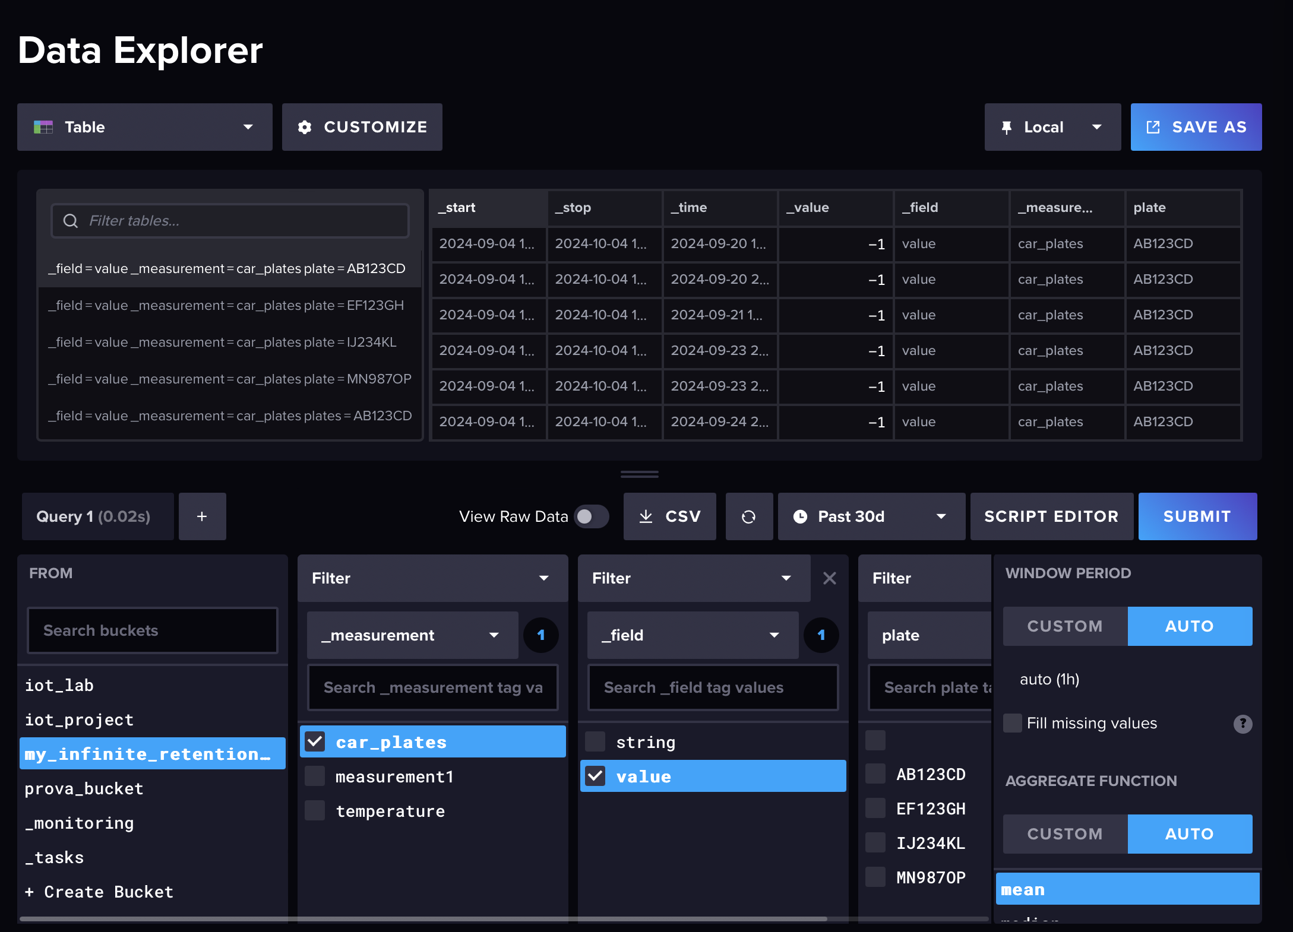
Database
Structured in a single bucket
Records with mapped values

Slide 22
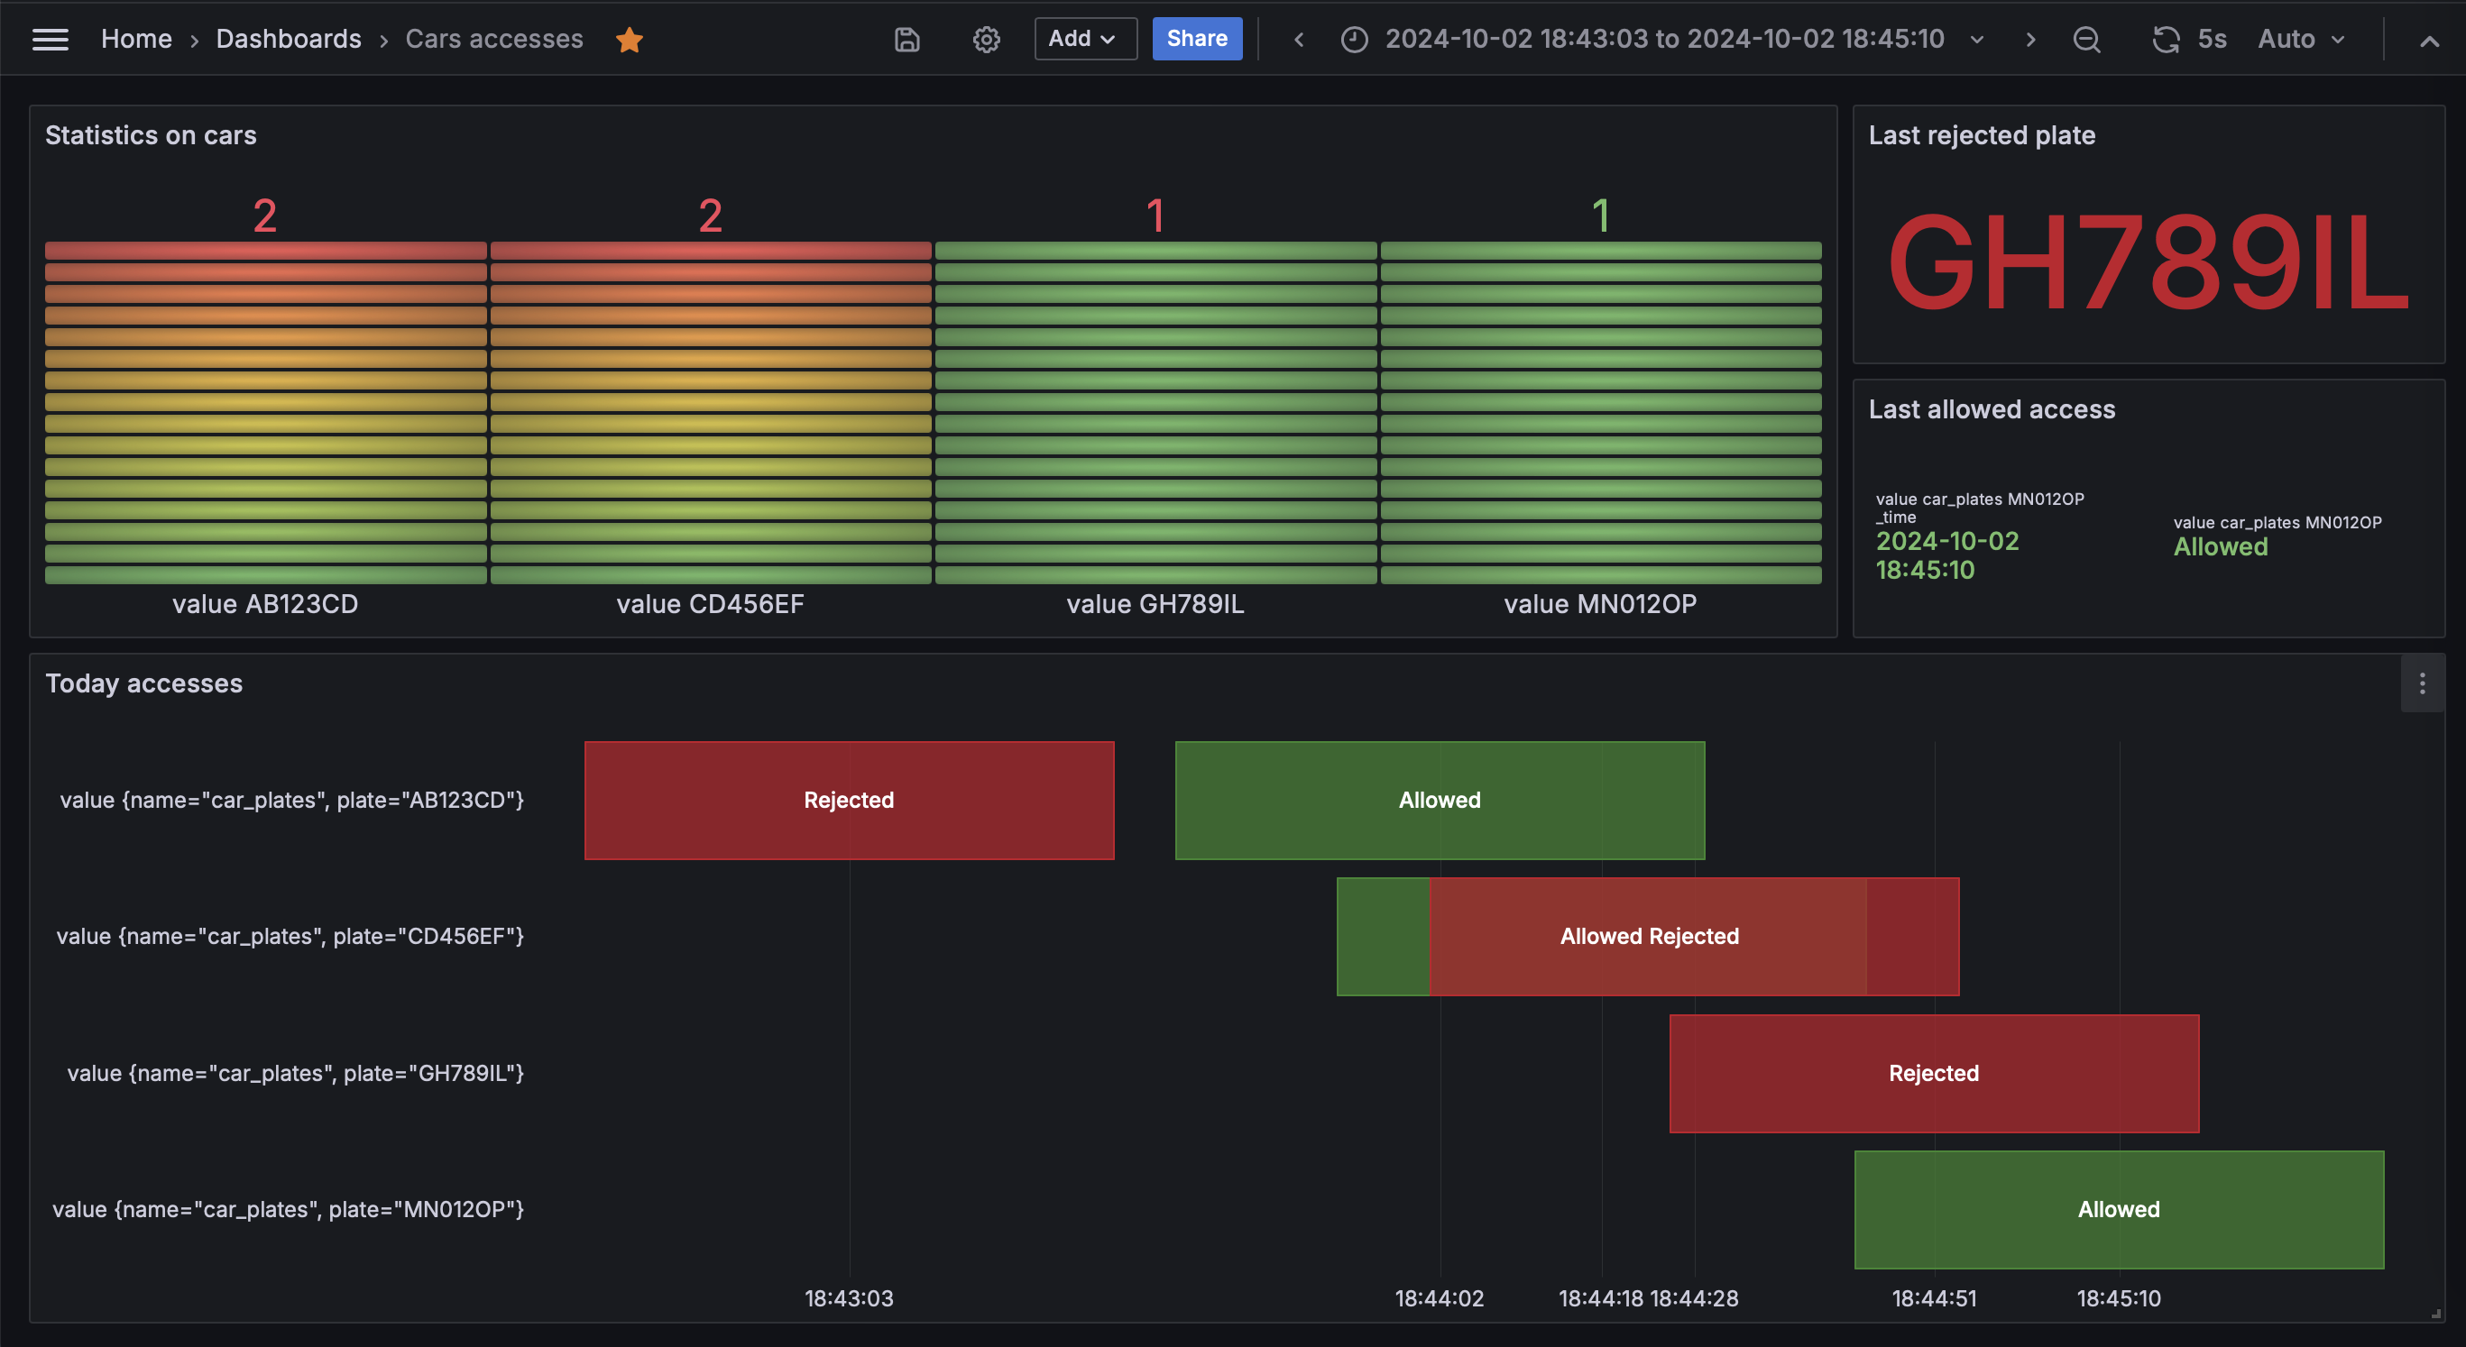
Dashboard
Unique interface
Statistics on vehicles accesses
Last allowed and rejected vehicle
Daily logs

Slide 23
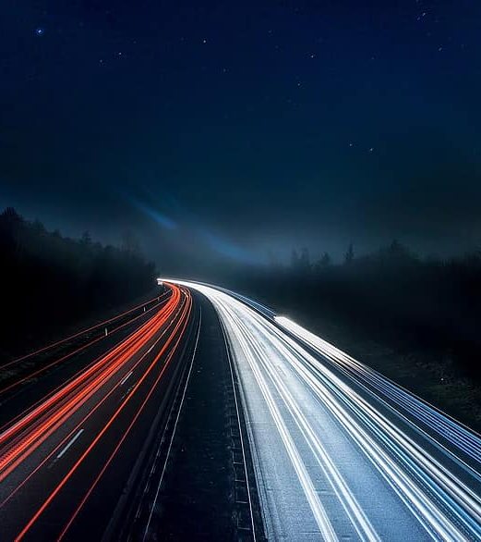
Future developments
Create a plate model for edge or fog device
Transmit data over LoRa
Store allowed edge devices in the database

